Slide 1
Presentation On
Front End Design For Hotel Management System
Edubridge Learning Private Limited
In partial fulfillment of the requirements for the award of Course in
SOFTWARE TESTING
Submitted By
Miss. Diksha G. Kunjarkar
(Center–Thane, Batch code –7670)

Slide 2
Contain
Web Development
Front End Development
Back End Development
Database Management System
Software Engineering
Software Testing
Selenium
Cucumber in Selenium

Slide 3
Web development refers to the creating, building, and maintaining of websites. It includes aspects such as web design, web publishing, web programming, and database management. It is the creation of an application that works over the internet i.e. websites.
Web Development can be classified into two ways:
Frontend Development
Backend Development
Frontend Development
The part of a website that the user interacts directly is termed as front end. It is also referred to as the ‘client side’ of the application.
HTML
CSS
JavaScript
Bootstrap

Slide 4
What is HTML
HTML stands for Hyper Text Markup Language. It is used to design web pages using the markup language. HTML is the combination of Hypertext and Markup language.
Hypertext defines the link between the web pages and markup language defines the text document within the tag that define the structure of web pages.
What is HTML used for
HTML is used to create the structure of web pages that are displayed on the World Wide Web (www).
It contains Tags and Attributes that are used to design the web pages. Also, we can link multiple pages using Hyperlinks.
HTML Basic Format Page Structure
It contains the essential building-block elements (i.e. doctype declaration, HTML, head, title, and body elements) upon which all web pages are created.

Slide 5
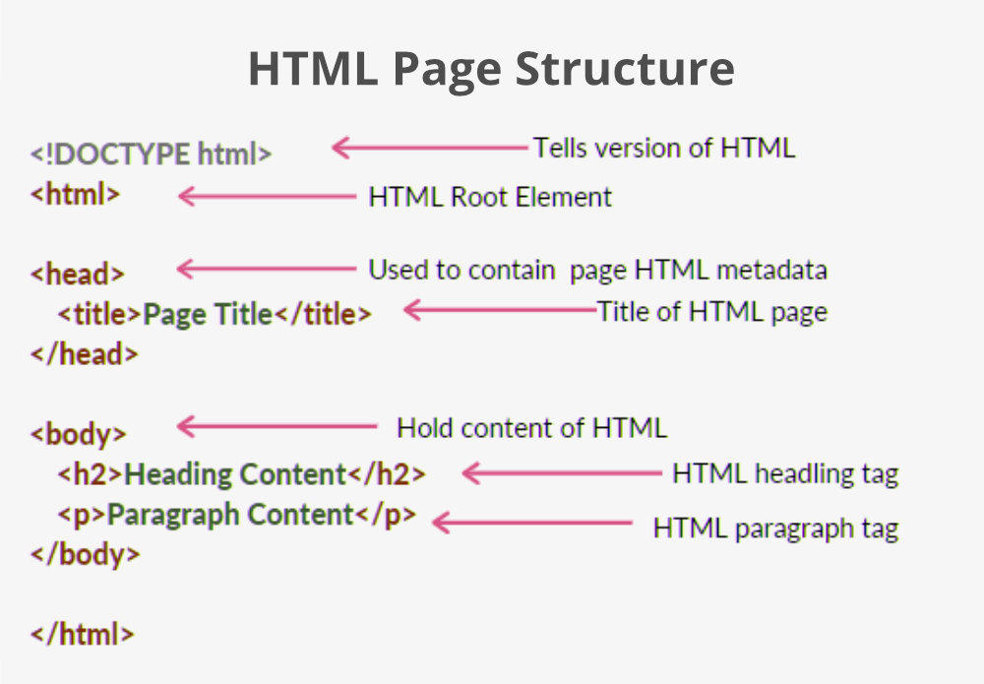

Slide 6
<DOCTYPE! html> – A doctype or document type declaration is an instruction that tells the web browser about the markup language in which the current page is written. It is not an element or tag. The doctype declaration is not case-sensitive.
<html> – This tag is used to define the root element of HTML document. This tag tells the browser that it is an HTML document. It is the second outer container element that contains all other elements within it.
<head> – This tag is used to define the head portion of the HTML document that contains information related to the document. Elements within the head tag are not visible on the front-end of a webpage.
<body> – The body tag is used to enclose all the visible content of a webpage. In other words, the body content is what the browser will show on the front end.

Slide 7
CSS
CSS (Cascading Style Sheets)is used to apply styles to web pages.
Cascading Style Sheets are fondly referred to as CSS. It is used to make web pages presentable.
The reason for using this is to simplify the process of making web pages presentable.
It allows you to apply styles on web pages. More importantly, it enables you to do this independently of the HTML that makes up each web page.
There are three types of CSS:
Inline: Inline CSS contains the CSS property in the body section attached with the element known as inline CSS.
Internal or Embedded: The CSS ruleset should be within the HTML file in the head section i.e. the CSS is embedded within the HTML file.
External: External CSS contains a separate CSS file that contains only style property with the help of tag attributes.

Slide 8
Basic Format:- body { background-color: lightgray; } h1 { color: green; text-align: center; } p { font-family: sans-serif; font-size: 16px; }

Slide 9
JavaScript
JavaScript (JS) is the most popular lightweight, interpreted compiled programming language.
It can be used for both Client-side as well as Server-side developments. JavaScript also known as a scripting language for web pages.
JavaScript can be added to your HTML file in two ways:
Internal JavaScript
External JavaScript
Internal JavaScript: We can add JS code directly to our HTML file by writing the code inside the <script> & </script>. The <script> tag can either be placed inside the <head> or the <body> tag according to the requirement.
External JavaScript: We can create the file with a .js extension and paste the JS code inside of it. After creating the file, add this file in <script src=”file_name.js”> tag, and this <sctipt> can import inside <head> or <body> tag of the HTML file.

Slide 10
Internal JavaScript: <!DOCTYPE html> <html lang="en"> <head> <title> Basic Example to Describe JavaScript </title> </head> <body> <!-- JavaScript Code --> <script> console.log("Welcome to GeeksforGeeks"); </script> </body> </html>

Slide 11
External JavaScript: <!DOCTYPE html> <html lang="en"> <head> <title> Basic Example to Describe JavaScript </title> <script src="main.js"></script> </head> <body> </body> </html>

Slide 12
Database Management System
Database management system is a software which is used to manage the database. For example:
MySQL, Oracle, etc are a very popular commercial database which is used in different applications.
DBMS provides an interface to perform various operations like database creation, storing data in it, updating data, creating a table in the database and a lot more.
It provides protection and security to the database. In the case of multiple users, it also maintains data consistency.
DBMS allows users the following tasks:
Data Definition: It is used for creation, modification, and removal of definition that defines the organization of data in the database.
Data Updation: It is used for the insertion, modification, and deletion of the actual data in the database.
Data Retrieval: It is used to retrieve the data from the database which can be used by applications for various purposes.
User Administration: It is used for registering and monitoring users, maintain data integrity, enforcing data security, dealing with concurrency control, monitoring performance and recovering information corrupted by unexpected failure.

Slide 13
SQL is a standard language for accessing and manipulating databases.
SQL Commands:
There are five types of SQL commands: DDL, DML, DCL, TCL, and DQL.
1. Data Definition Language (DDL)
DDL changes the structure of the table like creating a table, deleting a table, altering a table, etc.
All the command of DDL are auto-committed that means it permanently save all the changes in the database.
CREATE
ALTER
DROP
TRUNCATE
2. Data Manipulation Language
DML commands are used to modify the database. It is responsible for all form of changes in the database.
The command of DML is not auto-committed that means it can't permanently save all the changes in the database. They can be rollback.
INSERT
UPDATE
DELETE

Slide 14
3. Data Control Language
DCL commands are used to grant and take back authority from any database user.
Grant
Revoke
4. Transaction Control Language
TCL commands can only use with DML commands like INSERT, DELETE and UPDATE only.
These operations are automatically committed in the database that's why they cannot be used while creating tables or dropping them.
COMMIT
ROLLBACK
SAVEPOINT
5. Data Query Language
DQL is used to fetch the data from the database.
SELECT

Slide 15
Software Engineering
Software engineering is a process of analyzing user requirements and then designing, building, and testing software application which will satisfy that requirements. Software is a program or set of programs containing instructions that provide desired functionality. And Engineering is the process of designing and building something that serves a particular purpose and finds a cost-effective solution to problems.
Important reasons for using software engineering are: 1) Large software, 2) Scalability 3) Adaptability 4) Cost and 5) Dynamic Nature.
Three most important characteristics of good software are 1) Operational 2)Transitional 3)Maintenance.
Software Engineering is mainly used for large projects based on software systems rather than single programs or applications.
The main goal of software Engineering is to develop software application for improving the quality, budget and time efficiency.
Software Engineering ensures that the software that has to built should be consistent, correct, also on budget, on time and within the required requirements.
There are Four main Attributes of Software Engineering:-
Efficiency
Reliability
Robustness
Maintainability

Slide 16
Software Testing
Software testing can be stated as the process of verifying and validating whether a software or application is bug-free, meets the technical requirements as guided by its design and development, and meets the user requirements effectively and efficiently by handling all the exceptional and boundary cases.
Software testing can be divided into two steps: 1. Verification: it refers to the set of tasks that ensure that the software correctly implements a specific function.
2. Validation: it refers to a different set of tasks that ensure that the software that has been built is traceable to customer requirements.
Types of software testing
1. Manual Testing: Manual testing includes testing software manually, i.e., without using any automation tool or any script. In this type, the tester takes over the role of an end-user and tests the software to identify any unexpected behavior or bug. There are different stages for manual testing such as unit testing, integration testing, system testing, and user acceptance testing.
2. Automation Testing: Automation testing, which is also known as Test Automation, is when the tester writes scripts and uses another software to test the product. This process involves the automation of a manual process. Automation Testing is used to re-run the test scenarios quickly and repeatedly, that were performed manually in manual testing.

Slide 17
Different types of Software Testing Techniques
1. Black Box Testing: The technique of testing in which the tester doesn’t have access to the source code of the software and is conducted at the software interface without any concern with the internal logical structure of the software is known as black-box testing.
2. White-Box Testing: The technique of testing in which the tester is aware of the internal workings of the product, has access to its source code, and is conducted by making sure that all internal operations are performed according to the specifications is known as white box testing.
Different levels of software testing
1. Unit Testing: A level of the software testing process where individual units/components of a software/system are tested.
2. Integration Testing: A level of the software testing process where individual units are combined and tested as a group.
3. System Testing: A level of the software testing process where a complete, integrated system/software is tested.
4. Acceptance Testing: A level of the software testing process where a system is tested for acceptability.

Slide 18
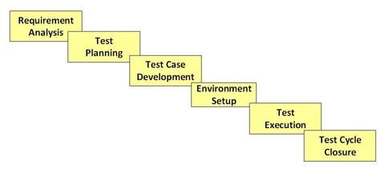
STLC Phases
STLC Model Phases Requirement Analysis
Test Planning
Test case development
Test Environment setup
Test Execution
Test Cycle closure

Slide 19
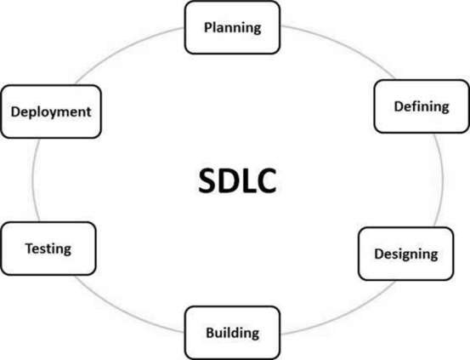
Software Development Life Cycle
SDLC is a process followed for a software project, within a software organization. It consists of a detailed plan describing how to develop, maintain, replace and alter or enhance specific software.

Slide 20
SDLC Models
There are various software development life cycle models defined and designed which are followed during the software development process. These models are also referred as Software Development Process Models".
Waterfall Model:-
It is also referred to as a linear-sequential life cycle model. It is very simple to understand and use. In a waterfall model, each phase must be completed before the next phase can begin and there is no overlapping in the phases.
Iterative Model:-In the Iterative model, iterative process starts with a simple implementation of a small set of the software requirements and iteratively enhances the evolving versions until the complete system is implemented and ready to be deployed.
Spiral Model:-The spiral model combines the idea of iterative development with the systematic, controlled aspects of the waterfall model. This Spiral model is a combination of iterative development process model and sequential linear development model i.e. the waterfall model with a very high emphasis on risk analysis. It allows incremental releases of the product or incremental refinement through each iteration around the spiral.

Slide 21
V-Model:-
The V-model is an SDLC model where execution of processes happens in a sequential manner in a V-shape. It is also known as Verification and Validation model.
Verification: It involves static analysis technique (review) done without executing code. It is the process of evaluation of the product development phase to find whether specified requirements meet.
Validation: It involves dynamic analysis technique (functional, non-functional), testing done by executing code. Validation is the process to evaluate the software after the completion of the development phase to determine whether software meets the customer expectations and requirements.
Big Bang Model:-
The Big Bang model is an SDLC model where we do not follow any specific process. The development just starts with the required money and efforts as the input, and the output is the software developed which may or may not be as per customer requirement. This Big Bang Model does not follow a process/procedure and there is a very little planning required. Even the customer is not sure about what exactly he wants and the requirements are implemented on the fly without much analysis.

Slide 22
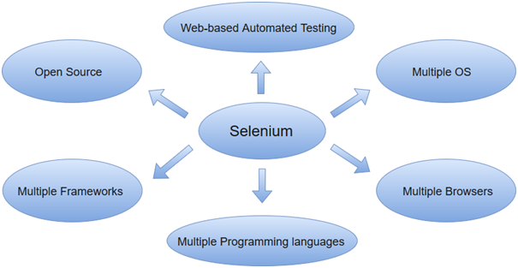
What is Selenium
Selenium is a free (open-source) automated testing framework used to validate web applications across different browsers and platforms.
You can use multiple programming languages like Java, C#, Python, etc to create Selenium Test Scripts. Testing done using the Selenium testing tool is usually referred to as Selenium Testing.

Slide 23
What is Cucumber
Cucumber is a testing approach which supports Behavior Driven Development (BDD). It explains the behavior of the application in a simple English text using Gherkin language.
Cucumber with Selenium
Selenium with Cucumber makes it easy to read and to understand the application flow.
Cucumber tool is based on the Behavior Driven Development framework that acts as the bridge between the following people:
Software Engineer and Business Analyst.
Manual Tester and Automation Tester.
Manual Tester and Developers.
Cucumber BDD framework also benefits the client to understand the application code as it uses Gherkin language which is in Plain Text. Anyone in the organization can understand the behavior of the software. The syntax’s of Gherkin is in simple text which is readable and understandable.
cucumber
Selenium

